Slide 1

Introduction to High Performance computing
Dr Etienne de Villiers
KEMRI Wellcome Trust Research Programme
Kilifi, Kenya

Slide 2

Why High Performance Computing?
Science and engineering needs
Replace complicated physical experiments by computer simulations
Evaluate more fine-grained models
User requirements
Compute masses of individual tasks
Compute complicated single tasks
Available computational power
Single workstation is not sufficient

Slide 3
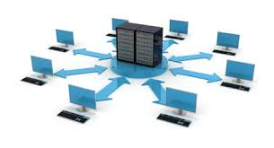
What Is It?
High Performance Computing (HPC)
Networking and Storage
Deals with high and highest performance computers, with high speed networks, and powerful disk and tape storage systems
Performance improvement
Compared to personal computers and small workstations:
Factor 100...10.000

Slide 4
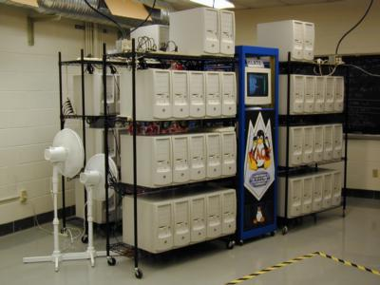
What Do I Need?
Small scale high performance computing
Cheapest version: use what you have
Workstations with disks and network
A bit more expensive: buy PCs
E.g. 16 personal computers with disks and gigabit ethernet
It´s mainly a human resources problem
Network of workstations is time consuming to maintain
Software comes for free

Slide 5

What Do I Need...?
Large scale high performance computing
Buy 10.000 PCs or a dedicated supercomputer
Buy special hardware for networking and storage
Add a special building
Add an electric power station

Slide 6

How Much Do I Have to Pay?
Small scale (<64 nodes)
1000€/node
Medium scale (64-1024 nodes)
2000€/node (multiprocessor, 64-bit)
1500€/node for high speed network
500€/node for high performance I/O
Large scale (>1024 nodes)
Money for building
Money for power plant
Current costs range between 20...400 million Euros

Slide 7
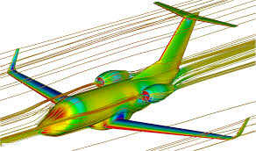
Application Fields
Numerical calculations and simulations
Particle physics
Computational fluid dynamics
Car crash simulations
Weather forecast
Commercial database applications
Non-numerical computations
Chess playing, theorem proving
Commercial database applications

Slide 8
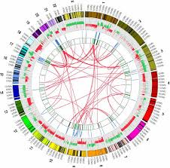
Application Fields...
All fields of Bioinformatics
Computational genomics
Computational proteomics
Computational evolutionary biology
…
In general
Everything that runs between 1 and 10.000 days
Everything that uses high volumes of data

Slide 9

Measures
Mega (10⁶) – Giga (10⁹) – Tera (10¹²) – Peta (10¹⁵) – Exa (10¹⁸)
Computational Performance (Flop/s)
Flop/s = floating point operations per second
Modern processor: 3 GFlop/s
Supercomputer: 1.88 ExaFlop/s (factor 1,000,000,000)
Network performance (Byte/s)
Personal computer: 10/100 MByte/s
Supercomputer networks: gigabytes/s

Slide 10
Measures...
Main memory (Byte)
Personal computer: 4 GByte
Supercomputer: 40 TByte
(factor 10,000)
Disk space (Byte)
Single disk 2004: 200 GByte
Supercomputer: PetaByte
(factor 1,000,000)
Tape storage (Byte)
Personal computer: 200 GByte
Supercomputer: 1.6 Pbyte
(factor 8,000)

Slide 11

Memory Architecture
How is the main memory organized?
Distributed memory architecture
Shared memory architecture

Slide 12
Distributed Memory Architecture
Autonomous computers connected via network
Processes on each compute node have access to local memory only
Parallel program spawns processes over a set of processors
Communication between computers (processes) via message passing
Called: multi computer system

Slide 13
Distributed Memory Architecture...
Advantages
Good scalability: just buy new nodes
Concept scales up to 10.000+ nodes
You can use what you already have
Extend the system when you have money and need for more power
Disadvantages
Complicated programming: parallelization of formerly sequential programs (including complicated debugging, performance tuning, load balancing, etc.)

Slide 14
Shared Memory Architecture
Several processors in one box (e.g. multiprocessor motherboard)
Each process on a processor sees complete address space
Communication between processes via shared variables
Called: multiprocessor system, symmetric multiprocessing system (SMP)

Slide 15
Shared Memory Architecture...
Advantages
Much easier programming
Disadvantages
Limited scalability: up to 64 processors
Reason: interconnection network becomes bottleneck
Limited extensibility
Very expensive due to high performance interconnection network

Slide 16
Hybrid Architectures
Use several SMP systems
Combination of shared memory systems and distributed memory system
The good thing: scalable performance according to your financial budget
The bad thing: programming gets even more complicated (hybrid programming)
The reality: vendors like to sell these systems, because they are easier to build
KWTRP and Pwani clusters are hybrid systems

Slide 17
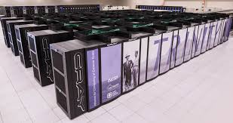
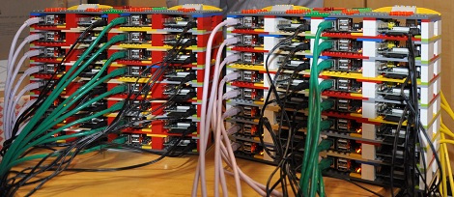

Supercomputers vs. Clusters
Supercomputers (Distributed/shared memory)
Constructed by a major vendor (IBM, HP, ...)
Use custom components (processor, network, ...)
Custom (Unix-like) operating systems
Clusters (Network of workstations, NOWs)
Assembled by vendor or users
Commodity-of-the-shelf components (COTS)
Linux operating system

Slide 18

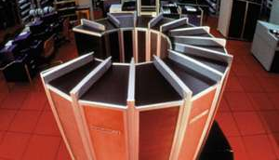
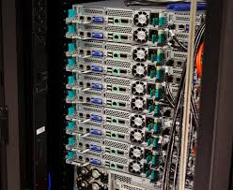
Supercomputers vs. Clusters...
Supercomputers
Very expensive to buy
Usually high availability and scalability
Clusters
Factor 10 cheaper to buy, but:
Very expensive to own
Lower overall availability and scalability

Slide 19
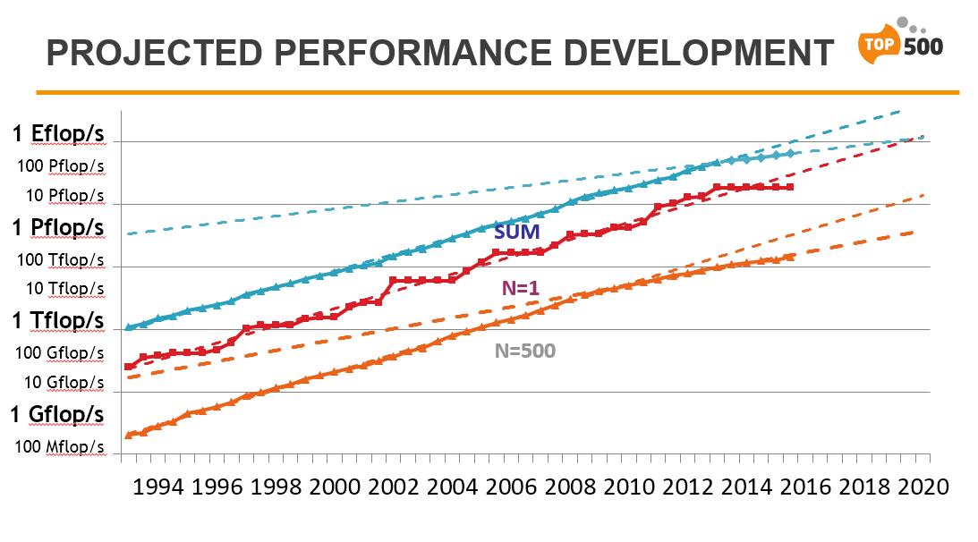

Slide 20
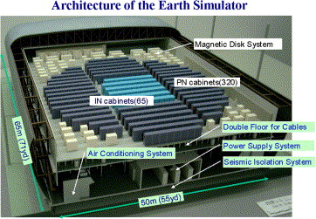
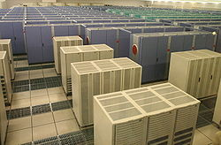
EarthSimulator / NEC

Slide 21
EarthSimulator / NEC
640 nodes x 8 processors
= 5120 processors
200Mio USD for computer
200Mio USD for building and electric power station
Building: 3250m2 earth quake protected
Power: 7MW = 7,000 homes
10TByte main memory
700TByte disk
1.6PBytes tapes
83,000 copper cables
2,800km / 220t of cabling
Application field: climate simulations

Slide 22
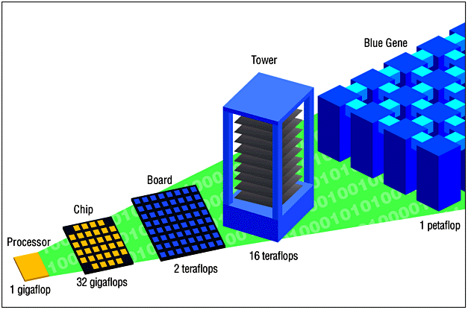
BlueGene / IBM

Slide 23
BlueGene / IBM
1PFlop/s
Power consumption and floor space problems solved by new packing technology ( less than 30 Earth- Simulators! ☺ )
Application fields:
Bioinformatics
Ab initio protein folding
Molecular dynamics on a
millisecond to second time scale
Protein structure prediction

Slide 24
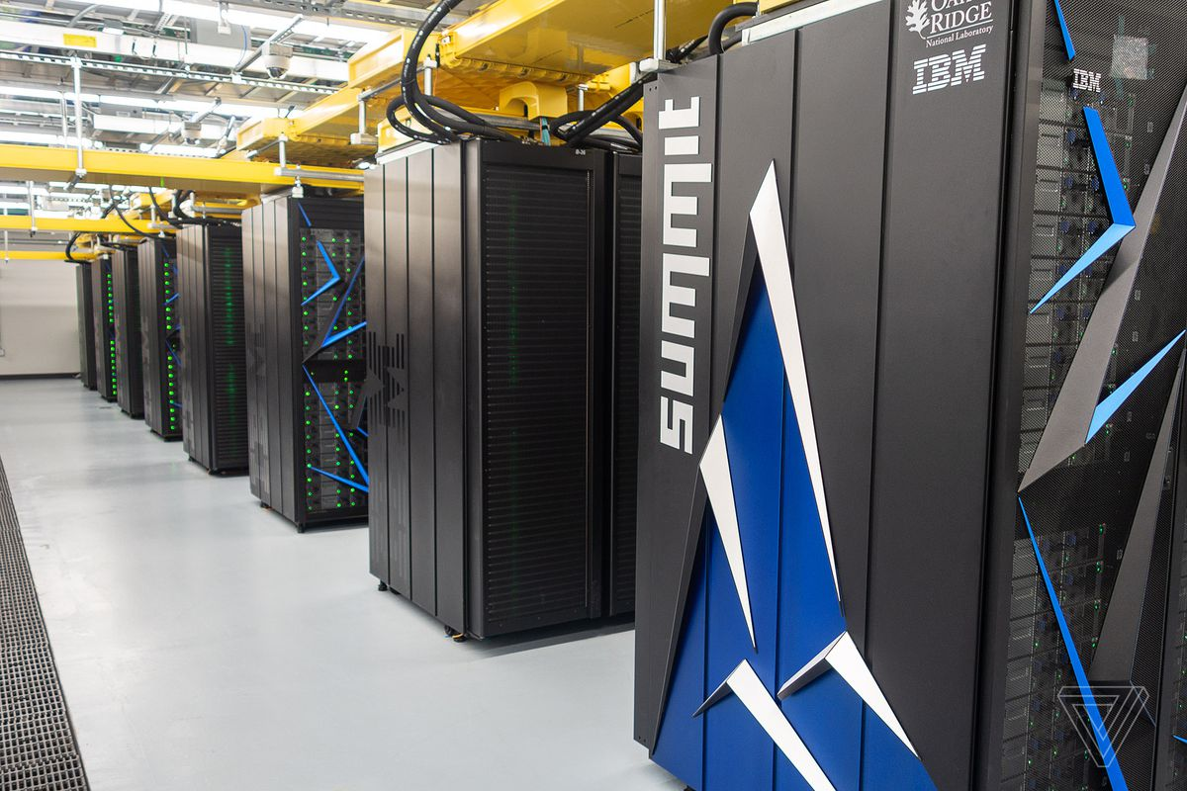
Summit (supercomputer)
IBM latest supercomputer
November 2018 is the fastest supercomputer in the world, capable of 200 petaflops
First supercomputer to reach ExaFlops (exa 10¹⁸ operations per second) speed, achieving 1.88 ExaFlops during a genomic analysis

Slide 25
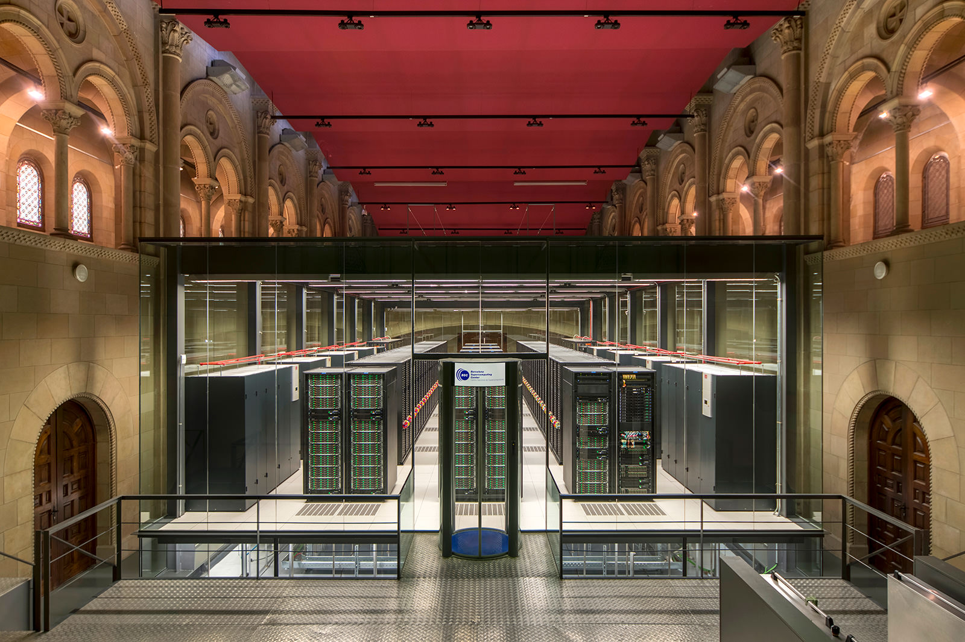
MareNostrum IV
European HPC in Barcelona
Peak Performance of 11.15 Petaflops
384.75 TB of main memory
3,456 cores
14 Petabytes disk storage

Slide 26
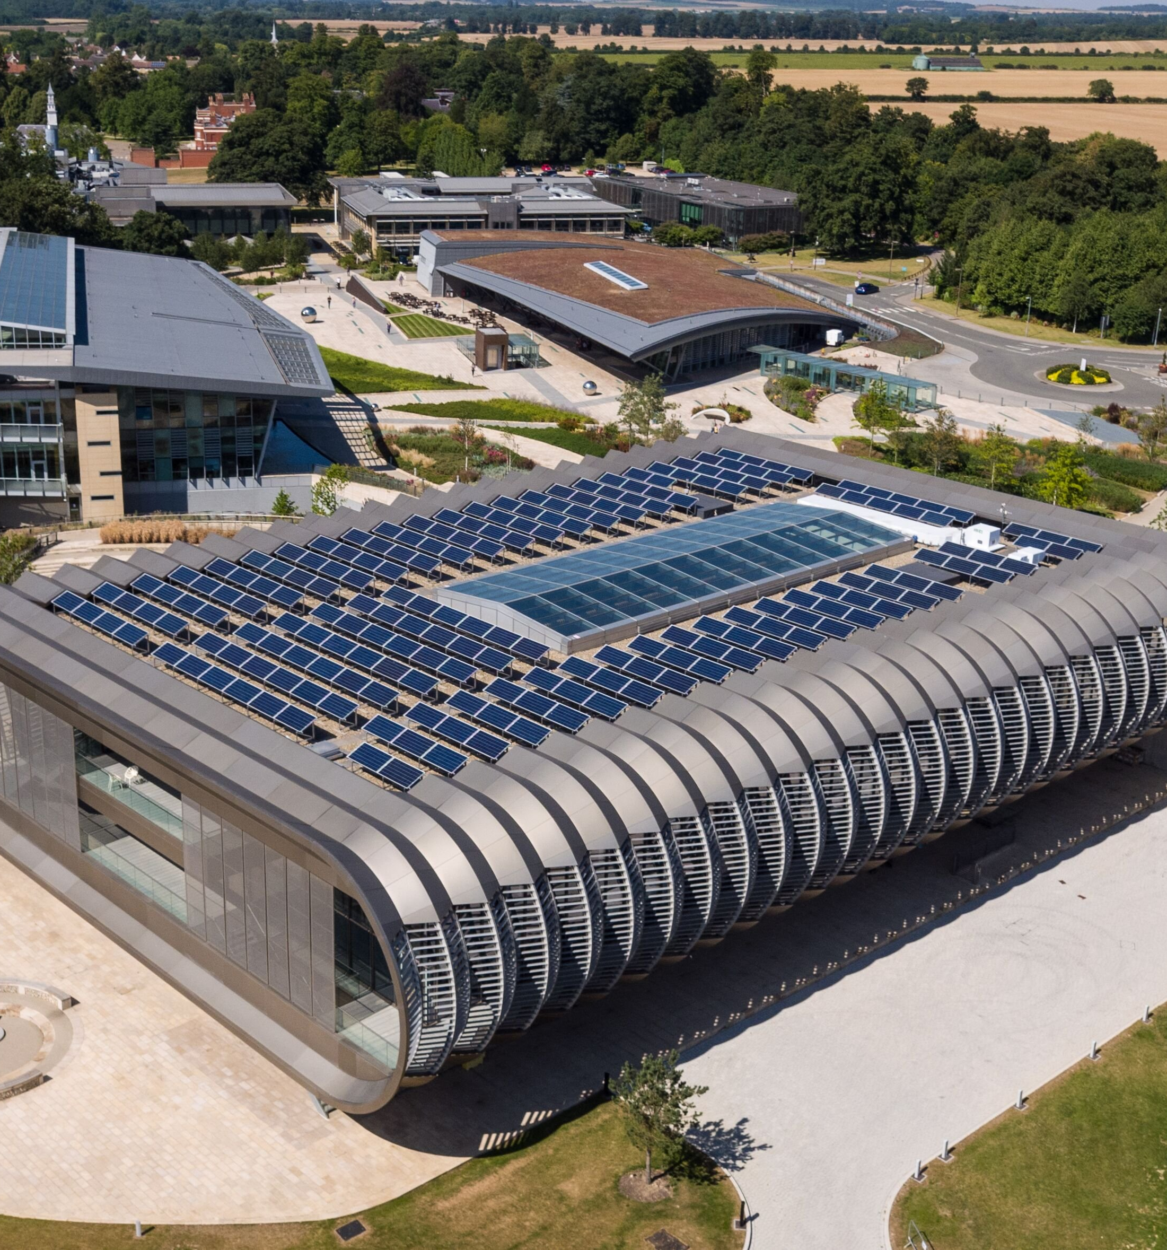
EMBL – EBI HPC
Based at Sanger Centre, Cambridge
330 TFLOPS
14,000 CPU cores
90 TB total RAM/memory
40 PB Data storage
doubling each 18 months

Slide 27
Types of computing problems
Tightly Coupled
1 + 1 = X
X + 2 = Y
Y + 3 = Z
N + Z = W
Embarrassingly Parallel
1 + 1 = X
2 + 2 = Y
3 + 3 = Z
N + N = W

Slide 28
Generic bioinformatics use case
Scientist has a problem
She does not want or need to run ONE parallel application stretching across a 100 CPU cluster
She wants to run one standalone program 100,000 or 1,000,000 times with slightly different input and output values
Embarrassingly Parallel
1 + 1 = X
2 + 2 = Y
3 + 3 = Z
N + N = W

Slide 29
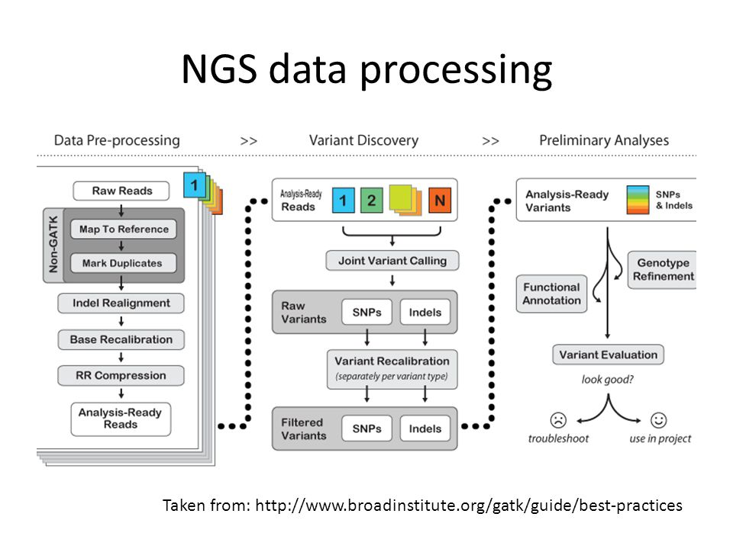
NGS data processing is embarrassingly parallel

Slide 30
Example: BLAST use case
Query.fa
Blast DB
Result
>Sequence1
Result1
>Sequence2
DB
>Sequence3
>SequenceN

Slide 31
Split BLAST by query sequence
Query.fa
Blast DB
Result
>Sequence1
Result2
>Sequence2
Result1
Result2
DB
>Sequence3
>SequenceN
ResultN
Result3
Result
Result3
ResultN

Slide 32
Split target databases & by query
>Sequence1
>Sequence2
DB
Result
>Sequence3
>SequenceN
DB
DB
Result
Result
DB
DB
Result
Result
DB
DB
Result
Result

Slide 33
Embarrassingly parallel tasks
lend themselves well to
“high performance computing”

Slide 34
Parallelization Paradigms...
Category 2: non-trivial parallelism
Usually: data partitioning
Data is partitioned amongst the processes
Each process computes results
During computation processes have to coordinate with each other: done by communication
A selected process organizes input/output
Example: Molecular dynamics simulations or genome assembly
Only for experienced programmers

Slide 35
Parallelization Support
Parallelization via automatically parallelizing compilers
Complicated, seldom, inefficient, not scalable
Parallelization for shared memory architectures
Language support via OpenMP
Only for small node numbers
Parallelization for distributed memory architectures
Done manually
Decorate program with message passing calls

Slide 36
Message Passing
Basic principle: use send and receive library calls to transfer data

Slide 37

Message Passing...
Message passing standard:
MPI (Message Passing Interface)
Conceived in the mid 90s
Language bindings: C, C++, Fortran (others available)
Divided into two parts
MPI: just message passing
MPI-2: process management, input/output, ...
Available implementations
Vendor versions on all major supercomputers
Open source versions openMPI
ABySS de novo sequence assembler uses openMPI

Slide 38
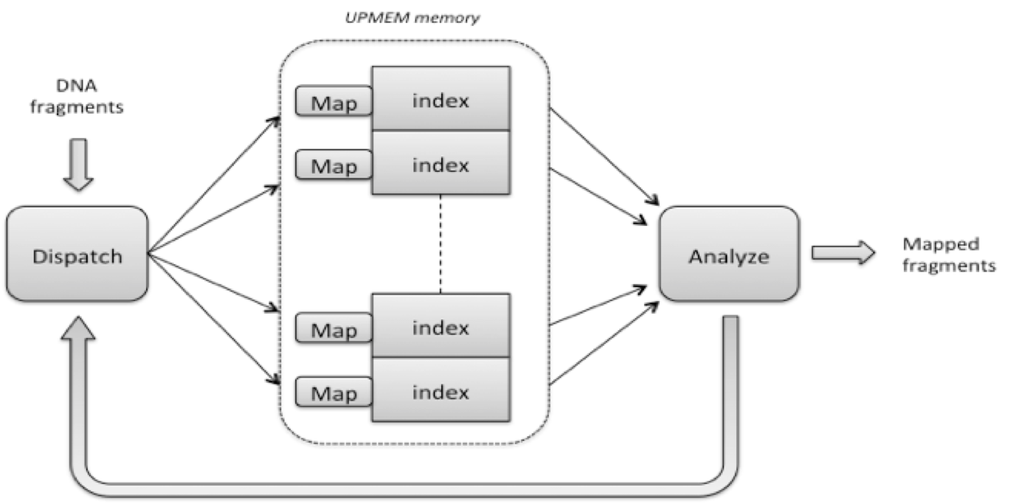
Mapping DNA sequences to reference

Slide 39
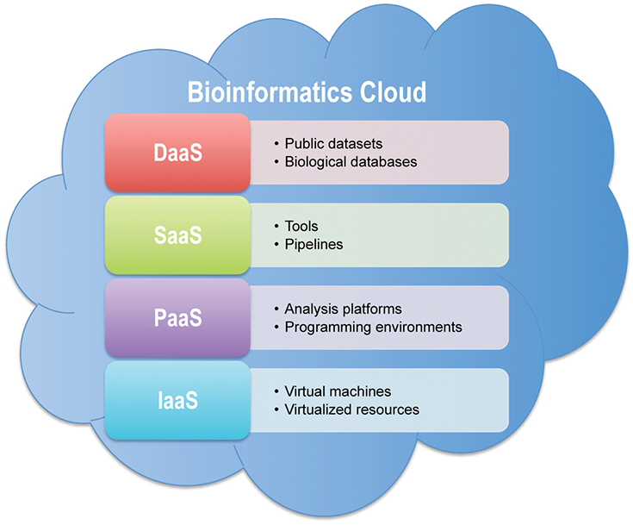
Cloud Computing
The Pros: Benefits and Advantages of Cloud Computing
Provides Cost Savings For Individuals and Organizations
Location Independence Through Remote Access
Scalability and Flexibility of IT Capabilities
All the Benefits of Outsourcing
The Cons: Limitations and Disadvantages of Cloud Computing
Lack of Full Control Over IT Capabilities
Issues Concerning Security and Privacy
Dependence on Internet Connectivity
Data motion and storage in the cloud can become very expensive

Slide 40
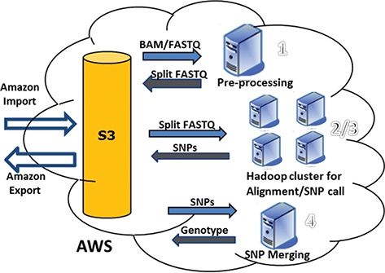
Rainbow AWS cloud
Rainbow: a tool for large-scale whole-genome sequencing data analysis using cloud computing
Detect SNPs in WGS data from a single subject.

Slide 41
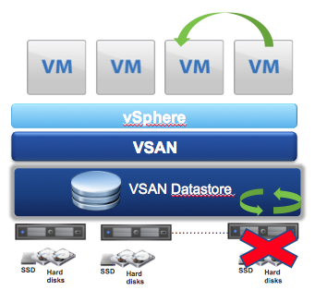
Hyper Converged Infrastructure
Is an IT framework that combines storage, computing and networking into a single system.
Run on commodity hardware.
The future?

Slide 42

What is available on your desktop?
Intel Core i7 4790 (Haswell) processor
4 cores at 4.0 GHz
8 double precision floating point operations per second (FLOP/s) – full fused multiply add instructions (FMAs)
2 floating point units (FPUs) per core
16 FLOP per cycle
64 GFLOP/s per core theoretical peak (4GHz)
256 GFLOP/s full system theoretical peak (4 cores)

Slide 43
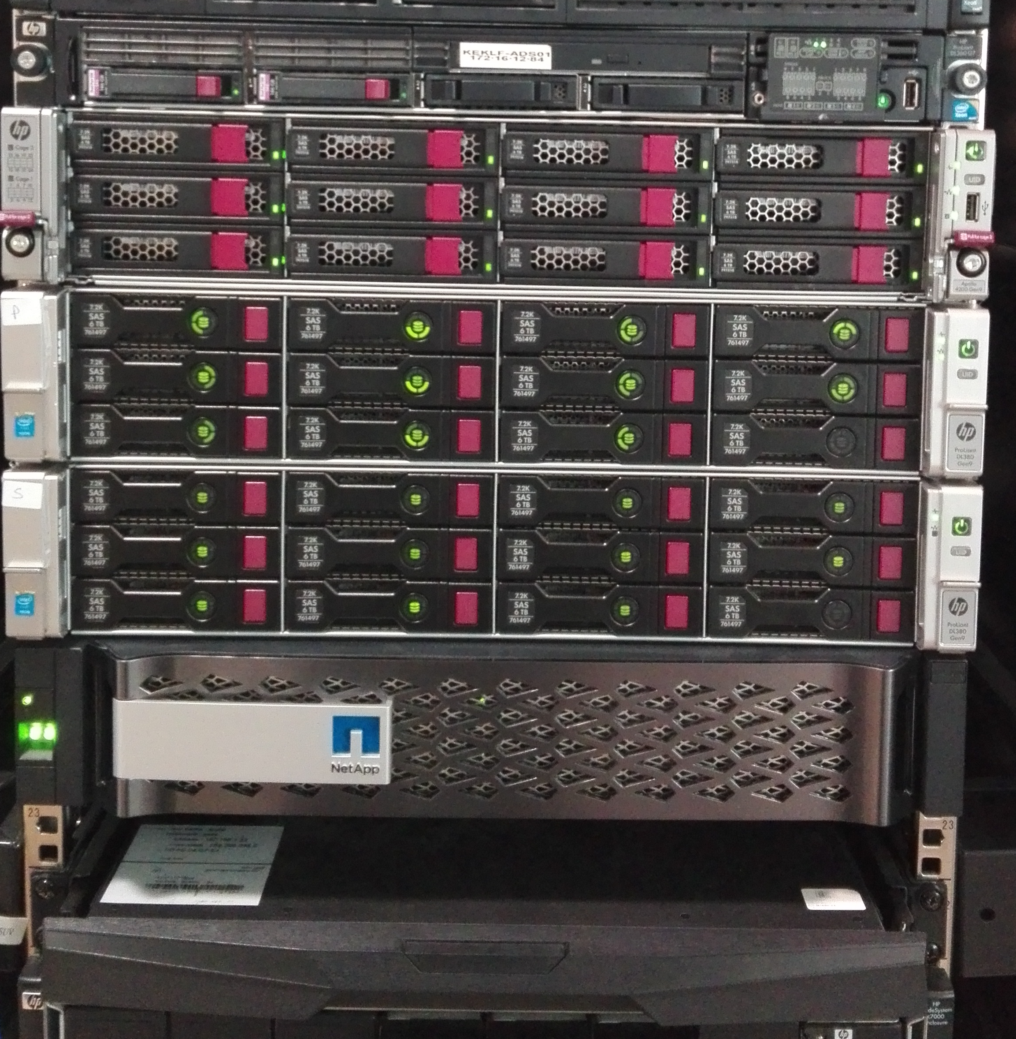


High Performance Compute Clusters
Group of servers connected with a dedicated high-speed network
KWTRP HPC
120 cpu/nodes
2.5 GHz, 12 core Haswell server processors
40 GFLOP/s per node theoretical peak
4.8 TFLOP/s total system theoretical peak
PUBReC HPC
16 cpus/nodes
3.3 GHz, 8 core Haswell server processors
40 GFLOP/s per node theoretical peak
0.3 TFLOP/s total system theoretical peak

Slide 44
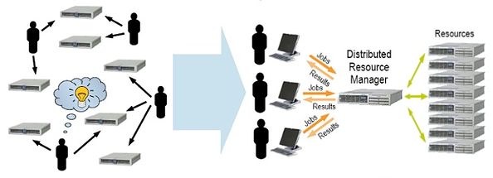
High Performance Linux cluster Job management
Unmanaged
Managed by SLURM

Slide 45
Computational Job
A job is a computational task
that requires processing capabilities (e.g. 64 nodes) and is subject to constraints (e.g. a specific other job must finish before the start of this job)
The job information is provided by the user
resource requirements
CPU architecture, number of nodes, speed
memory size per CPU
software libraries, licenses
I/O capabilities
job description
additional constraints and preferences
The format of job description is not standardized, but usually very similar

Slide 46
Resource Management on HPCs
HPCs are usually parallel computers or large-scale clusters
The local resource management systems (RMS) for such resources includes:
configuration management
monitoring of machine state
job management
There is no standard for this resource management.
Several different proprietary solutions are in use.
Examples for job management systems:
SLURM, PBS, Condor

Slide 47
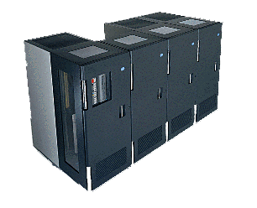
HPC Management Architecture in General
Control Service Job Master
Master Server
Resource and Job Monitoring and Management Services
Resource/ Job Monitor
Resource/ Job Monitor
Resource/ Job Monitor
Compute Node
Compute Node
Compute Node
Compute Resources/ Processing Nodes

Slide 48
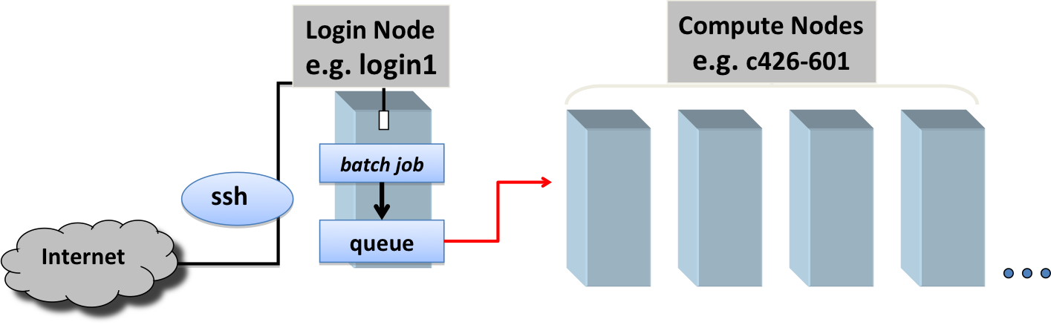
Job Submission with SLURM

Slide 49

SLURM workload manager
Slurm is an open source, fault-tolerant, and highly scalable cluster management and job scheduling system for large and small Linux clusters
Slurm has three key functions:
Allocates exclusive and/or non-exclusive access to resources (compute nodes)
Provides a framework for starting, executing, and monitoring work processes on the set of allocated nodes
Arbitrates contention for resources by managing a queue of pending work

Slide 50
SLURM commands
sinfo - reports the state of partitions and nodes managed by SLURM
smap - reports state information for jobs, partitions, and nodes
sbatch - is used to submit a job script for later execution
squeue - reports the state of jobs or job steps.
srun - is used to submit a job for execution in real time
scancel - is used to stop a job early.

Slide 51
SLURM commands ….
sinfo -lNe
NODELIST NODES PARTITION STATE CPUS S:C:T MEMORY TMP_DISK WEIGHT AVAIL_FE REASON
pubrec-bkup-01 1 batch completing* 8 1:8:1 1 0 1 (null) none
pubrec-cls-01 1 debug* idle 8 1:8:1 1 0 1 (null) none
pubrec-cls-01 1 batch idle 8 1:8:1 1 0 1 (null) none

Slide 52
SLURM Queue Structure
Pubrec
PARTITION TIMELIMIT PURPOSE
debug* 5-23:59:00 interactive and/or development
batch infinite normal production
KWTRP
PARTITION TIMELIMIT PURPOSE
debug* 5-23:59:00 interactive and/or development
batch infinite normal production
longrun infinite queue for long-running jobs
highmem infinite large memory

Slide 53
Job Submission with SLURM
The user “submits” the job to the RMS e.g. issuing
“sbatch jobscript.pbs”
The user can control the job
sbatch: submit
sinfo: poll status information
scancel: cancel job
It is the task of the resource management system to start a job on the required resources
Current system state is taken into account
Can also submit interactive jobs
reserve CPU and memory for use

Slide 54
Example: SLURM Job Description
Simple job script:
whole job file is a shell script
#!/bin/bash #
#SBATCH -n 10 # Number of cores
#SBATCH -p longrun
#SBATCH --mem-per-cpu 1024
#SBATCH --mail-user=evilliers@kemri-wellcome.org
#Commands to run. Replace example below with your arguments and variables.
module load python/3.4.3
module load blastall/2.5.6
blastall –I query_seq.fa -d nr_database -p blastp
information for the RMS are comments
the actual job is started in the script

Slide 55

Job Steps
A user job enters a job queue,
the scheduler (its strategy) decides on start time and resource allocation of the job.
Scheduler
time
Job Execution Management
Schedule
User
Job Description
Job-Queue
Node Job Mgmt
Node Job Mgmt
Node Job Mgmt
HPC Computer

Slide 56
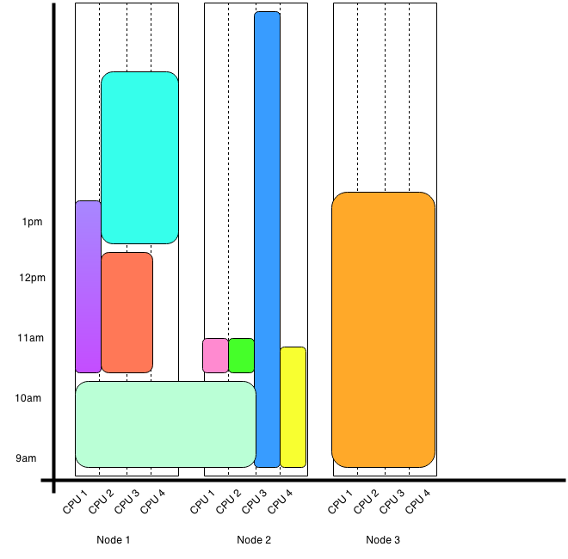
SLURM Job Scheduler
Priority factors
age: how long the job has been waiting in the queue,
fair share: a measure of past usage of the cluster by the user,
size: the number of CPUs a job requests

Slide 57
Execution Alternatives
Time sharing:
The local scheduler starts multiple processes per physical CPU with the goal of increasing resource utilization.
multi-tasking
The scheduler may also suspend jobs to keep the system load under control
preemption
Space sharing:
The job uses the requested resources exclusively; no other job is allocated to the same set of CPUs.
The job has to be queued until sufficient resources are free.

Slide 58
Job Classifications
Batch Jobs vs interactive jobs
batch jobs are queued until execution
interactive jobs need immediate resource allocation
Parallel vs. sequential jobs
a job requires several processing nodes in parallel
The majority of HPC installations are used to run batch jobs in space-sharing mode!
a job is not influenced by other co-allocated jobs
the assigned processors, node memory, caches etc. are exclusively available for a single job.
overhead for context switches is minimized
important aspects for parallel applications

Slide 59
Preemption
A job is preempted by interrupting its current execution
the job might be on hold on a CPU set and later resumed; job still resident on that nodes (consumption of memory)
alternatively a checkpoint is written and the job is migrated to another resource where it is restarted later
Preemption can be useful to reallocate resources due to new job submissions (e.g. with higher priority)
or if a job is running longer then expected.

Slide 60
Job Scheduling
A job is assigned to resources through a scheduling process
responsible for identifying available resources
matching job requirements to resources
making decision about job ordering and priorities
HPC resources are typically subject to high utilization
Therefore, resources are not immediately available and jobs are queued for future execution
time until execution is often quite long (many production systems have an average delay until execution of >1h)
jobs may run for a long time (several hours, days or weeks)

Slide 61
Accelerators and Many Integrated Cores
Typical CPUs are not very energy efficient
Meant to be general purpose, which requires lots of pieces to the chip
Accelerators package much more FLOP capabilities with less energy consumption
Not exactly general purpose
Always requires more work from the programmer
Performance improvements and application porting may take significant effort

Slide 62


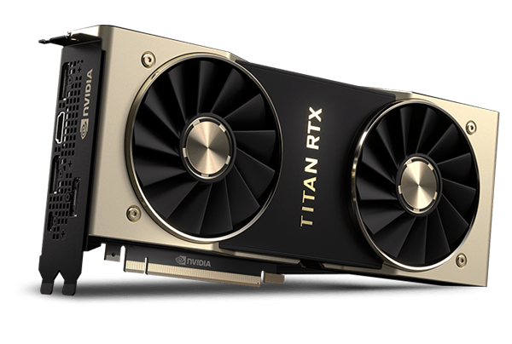
GPU Accelerators
A graphics processing unit (GPU) as accelerators
NVIDIA GPUs can be used to perform calculations
Latest Turing generation offer 130 TFLOPs in a single package

Slide 63
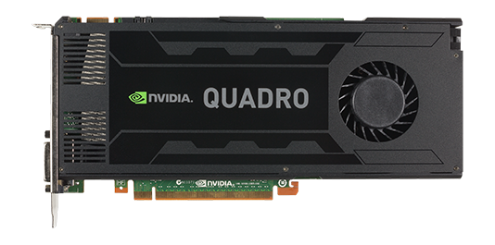
GPU enabled software
NVIDIA quadro K4200 GPU module (1344 CUDA Cores, 4GB GPU Memory) on KWTRP HPC
CUDASW++: Smith-Waterman protein database search to perform sequence searches 10x-50x faster than NCBI BLAST
BarraCUDA: bwa based short read aligner
MUMmerGPU: high-throughput parallel pairwise local sequence alignment program
KBiC

Slide 64
cudasw.sbatch
#!/bin/env bash
#SBATCH --job-name=cudasw
#SBATCH --nodes=1
#SBATCH --ntasks-per-node=20
#SBATCH -p longrun
#SBATCH -w keklf-cls01
#SBATCH --gres=gpu:1
#SBATCH --mail-user evilliers@kemri-wellcome.org
#Command to run.
module load cudasw/v3.1.1
cudasw -query Queries/all.fasta –db uniprot_sprot.fasta -use_single 1
KBiC

Slide 65
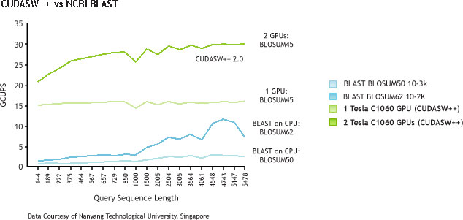
GPU-enabled Smith-Waterman
CUDASW++ compared to BLASTP
KBiC

Slide 66
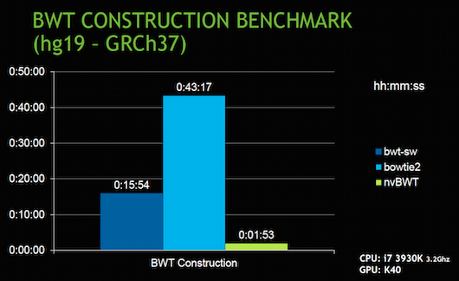
GPU accelerated Bowtie2
BWT-SW and Bowtie2 compared to nvBWT on human reference genome build hg19.
nvBWT about 8X and 21X faster than BWT-SW and Bowtie2, respectively.
KBiC

Slide 67


Pubrec HPC server
16 CPUs
64 GB RAM
8 TB Disk storage
8 TB backup storage server
Centos 7 operating system
SLURM job scheduler

Slide 68
Access to Pubrec HPC
Users access the Pubrec HPC server through ssh connection to their user accounts.
User account will only be activated after a short induction training session.
Only you have access to your directory and workspace.
Currently hard disk space usage is not restricted.
However we will regularly check for duplication of large files and remove them.
Use soft links:
ctx.112.fastq -> /home/data/iontorrent/ctx_plasma/ctx.112.fastq
KBiC

Slide 69

Thank you

